Slide 1

Algorithms and Data Structures 1 CS 0445
Fall 2023
Sherif Khattab
ksm73@pitt.edu
(Slides are adapted from Dr. Ramirez’s and Dr. Farnan’s CS1501 slides.)

Slide 2
Announcements
Upcoming Deadlines:
Homework 3: Tuesday 9/19 @ 11:59 pm
Lab 2: Friday 9/22 @ 11:59 pm
Programming Assignment 1: Friday 9/29 @ 11:59 pm
Post-lab exercises are optional
SCI Week is happening this week!
Professional Development opportunities

Slide 3
ArrayBag
ArrayBag is an implementation of the ADT Bag that uses a fixed-size array
String[10] uses the same memory as Integer[10], ArrayBag[10], Square[10], …
Each array has 10 reference variables, and all reference variables have the same size (e.g., 4 bytes)
Allocating an array of Type parameter T
@SuppressWarnings(“unchecked”)
T[] tempBag = (T[]) new Object[capacity];
An empty array takes up the same space in memory as a filled array
all reference variables inside an array are allocated when the array is created

Slide 4
NullPointerException
NullPointerException is a run-time exception raised by the Java run-time every time a reference variable with null value is dereferenced using the dot operator
e.g., ArrayBag<Integer> x;
x.add(10);
The code above will raise a NullPointerException because the reference variable x is dereferenced while null.
How would you fix that?

Slide 5
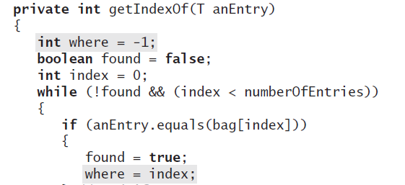
Hiding Implementation Details
Should we add getIndexOf(T entry) as a public method to BagInterface?
No!
A Bag maintains its items in no particular order.
Allowing the client to get the index of an item implicitly promises the client that the item will remain at that index;
which is not guaranteed!

Slide 6
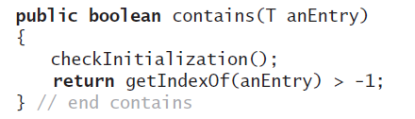
Revised definition for the method contains

Slide 7
Pros and Cons of Fixed-size Arrays
(+) Adding an entry to the bag is fast
(+) Removing an unspecified entry is fast
(-) May be wasteful of memory
for example, we have 10 items in ArrayBag, but we expect that we will have 1,000,000 items later
how big should the array be?

Slide 8
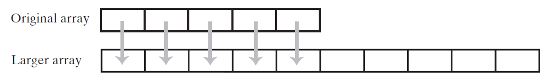
Using Array Resizing
Resizing an array copies its contents to a larger second array

Slide 9
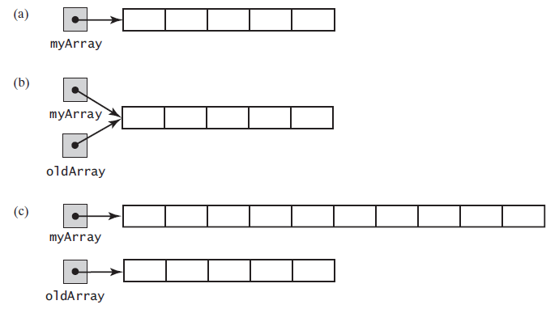
Array Resizing
two references to the same array
original array variable now references a new, larger array

Slide 10
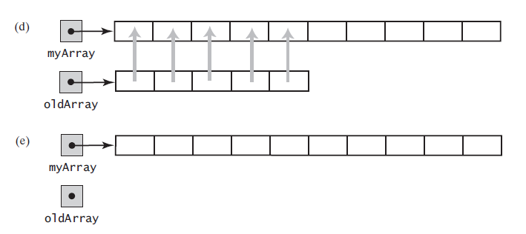
Array Resizing (contd)
the entries in the original array are copied to the new array
the original array is discarded

Slide 11
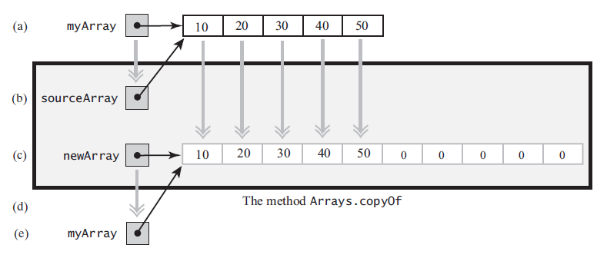
Using Array Resizing
myArray = Arrays.copyOf(myArray, 2 * myArray.length);
argument array
parameter
new, larger array
argument variable assigned the parameter

Slide 12
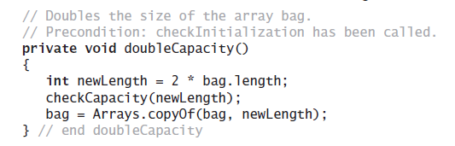
Doubling the array capacity
Check ResizableArrayBag in code handouts

Slide 13
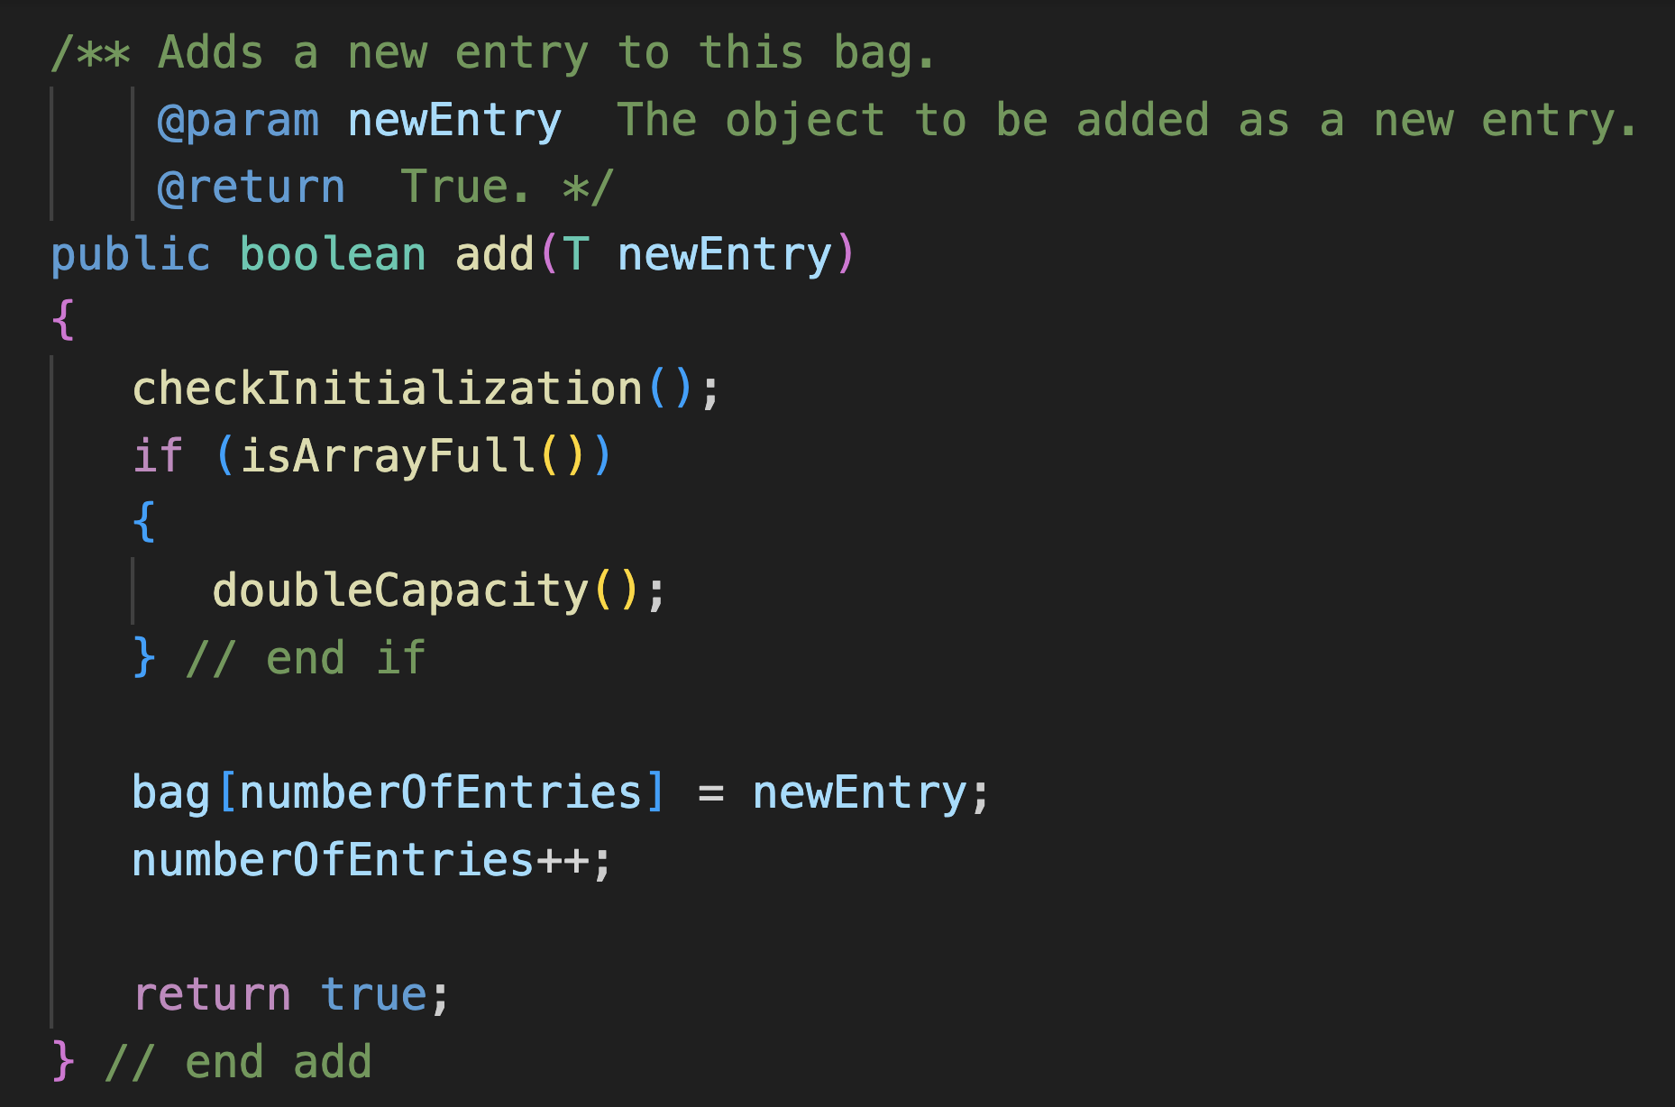
ResizableArrayBag: add
Should we double the capacity before or after adding the item to the array?

Slide 14

ResizableArrayBag
Can we still have the final keyword for the underlying array?
No!

Slide 15
Pros and Cons of Arrays
(+) Adding an entry to the bag is fast
(+) Removing an unspecified entry is fast
(-) May be wasteful of memory
for example, we have 10 items in ArrayBag, but we expect that we will have 1,000,000 items later
how big should the array be?
increasing the size of the array requires time to copy its entries

Slide 16
Array vs. Linked Implementation
An array may contain empty slots
Array
filled entry
empty entry

Slide 17
Linked Implementation has no empty slots
Linked Chain
filled entry

Slide 18
Linked Implementation
Linked Chain
filled entry

Slide 19
Linked Implementation
Linked Chain
null
filled entry
next field

Slide 20
Pros of Using a Linked Chain
LinkedBag can grow and shrink in size as necessary
Can remove and recycle nodes that are no longer needed
Java’s garbage collection

Slide 21
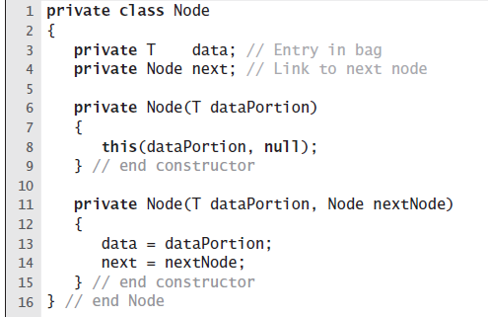
The Private Class Node
The private inner class Node

Slide 22
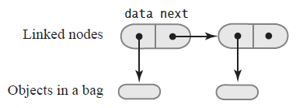
The Private Class Node
Two linked nodes that each references object data

Slide 23
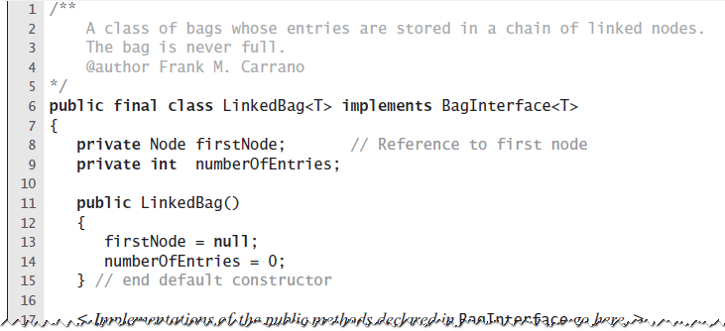
Class LinkedBag
Keep track of the first node in the chain only!

Slide 24
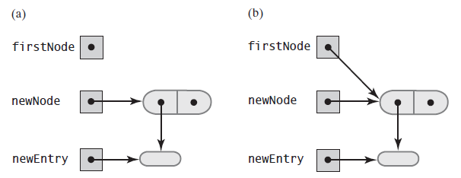
Case 1: Beginning a Chain of Nodes
An empty chain and a new node
The chain after adding the new node
firstNode = newNode;

Slide 25
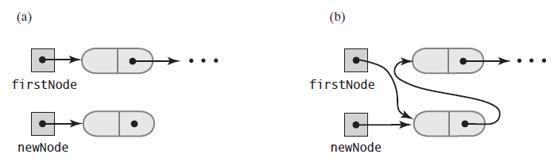
Case 2: Adding to an existing Chain
just prior to adding a node at the beginning
just after adding a node at the beginning
newNode.next = firstNode;
firstNode = newNode;
What happens if we do firstNode = newNode first?
We will lose the chain!

Slide 26
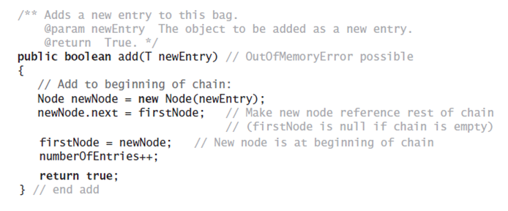
LinkedBag.add
This code is exactly Case 2 code
Why does it work for Case 1 (adding to an empty chain) as well?

Slide 27
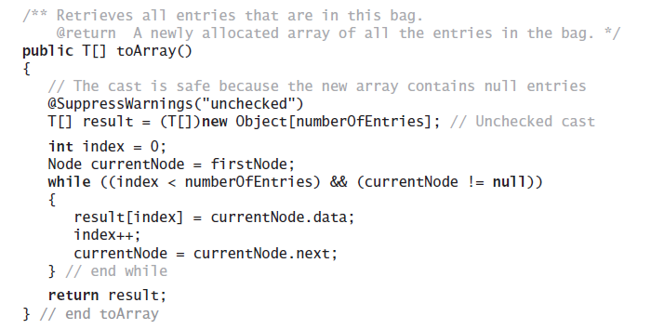
Traversing a Chain of nodes

Slide 28
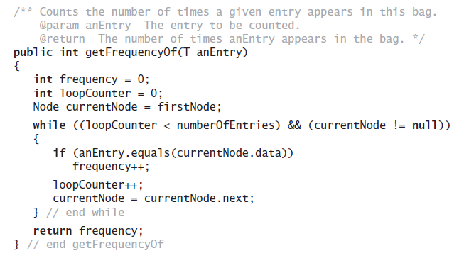
Method getFrequencyOf
Counts the number of times a given entry appears
Also traverses the chain

Slide 29
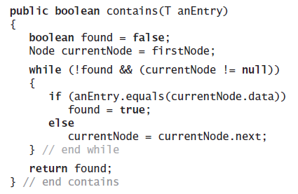
Method contains
Determine whether a bag contains a given entry

Slide 30
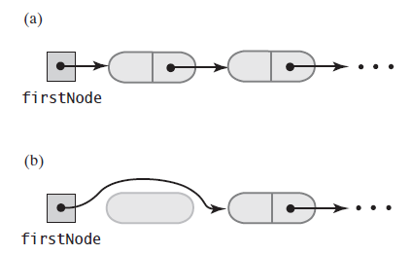
Removing an unspecified item
just prior to removing the first node
just after removing the first node
firstNode = firstNode.next;

Slide 31
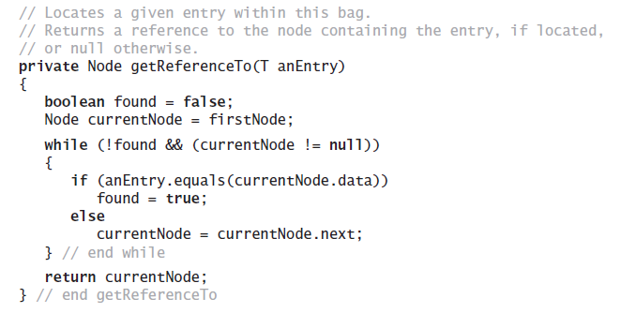
Removing a specified item
getReferenceTo returns a reference to a node with .data.equals(anEntry)

Slide 32
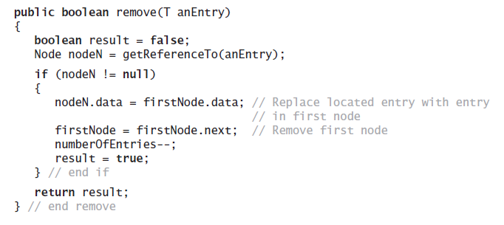
Method remove
Similar trick to what we did in ArrayBag.remove(T)
replace data by data of first item
Note use of method getReferenceTo

Slide 33
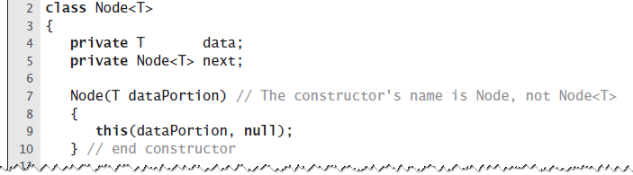
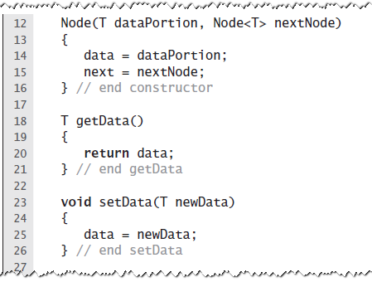
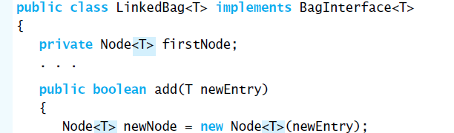
Node as a Public class
Node can be implemented as an independent class
Needs to be generic!

Slide 34
Cons of Using a Chain
Chain requires more memory than a full array
Full Array
Logical Size = Physical Size = 5
null
Linked Chain
Requires double the memory

